Slide 1
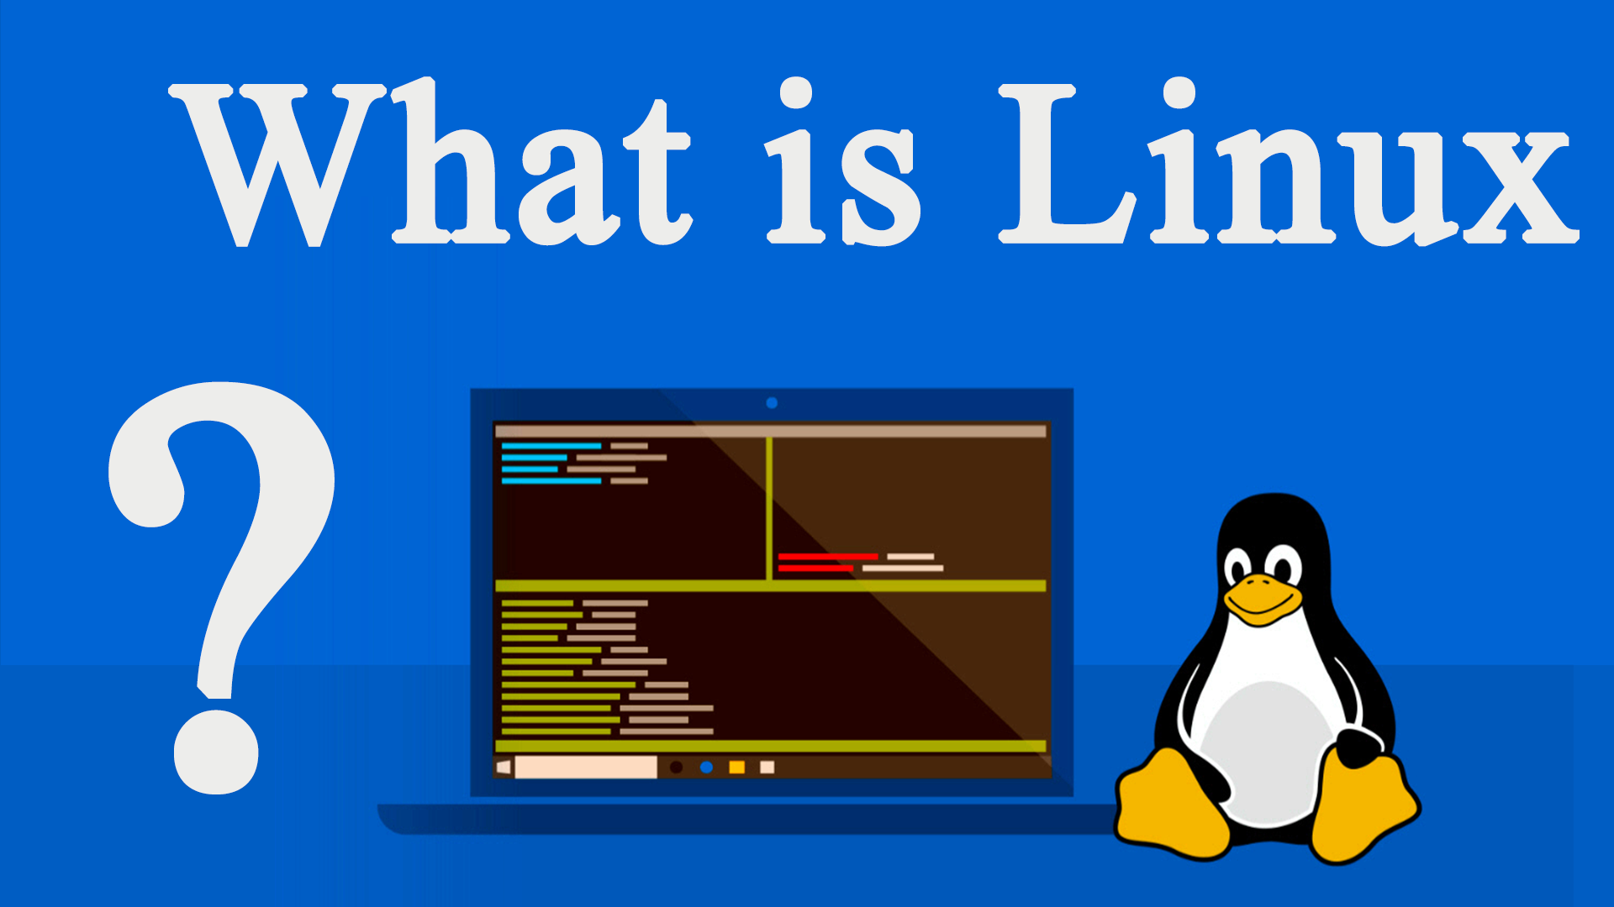
Introduction

Slide 2
After finishing this course you will gain:
Installing Linux in different ways
Review of the Linux Graphic Interface
Easily work with Linux Terminal
Working with Files, Directories, file contents
Be familiar with linux file tree
Working with filters
Setting up servers: NTP, DNS, DHCP, Nginx , Apache, MySQL, PostgreSQL, NFS, Mail Servers
Virtualization technologies: Proxmox, Vmware, VirtualBox, ESXi
Firewalls: Opensense, Pfsense
Monitoring systems: Zabbix, Prometheus , Grafana

Slide 3
Statistics
Maybe you are thinking – Windows claims 82.56% of the world’s OS market.
In January 2021, 1.93% of all desktop operating systems worldwide ran on Linux.

Slide 4
Mind-blowing Linux Statistics
In 2021, 100% of the world’s top 500 supercomputers run on Linux.
Out of the top 25 websites in the world, only 2 aren’t using Linux: https://www.alexa.com/topsites
96.3% of the world’s top 1 million servers run on Linux.
90% of all cloud infrastructure operates on Linux and practically all the best cloud hosts use it.
85% of all smartphones are based on Linux.

Slide 5
Linux Usage Statistics, 2021
25.3% of professional developers used Linux in 2018.
36.7% of the websites with known operating systems use Linux.
54.1% of professional developers use Linux as a platform in 2019.
83.1% of developers say Linux is the platform they prefer to work on.
As of 2017, more than 15,637 developers from 1,513 companies had contributed to the Linux kernel code since its creation.

Slide 6
Main Terms
Operating Systems
Hardware
Software
Kernel
Drivers
GUI
CLI
Shell
Open Source

Slide 7
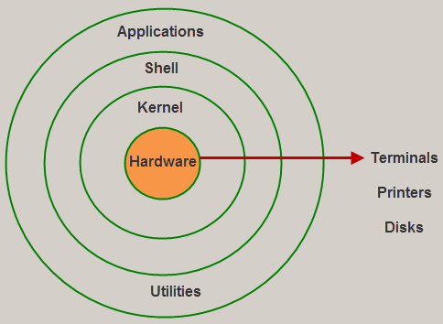
Linux Architecture

Slide 8
Linux History
In 1991 a Finish student named Linus Torvalds created the Linux kernel. Linus first started working on a terminal emulator to connect to Unix systems at his university but over time that project grew into something bigger and eventually became the Linux kernel. Combining the Linux kernel with the GNU Foundation’s command line tools created a complete Unix-like operating system. Shortly after the release of the Linux kernel collections of various software combined with the Linux kernel started to appear. These sets of software became known as Linux distributions.

Slide 9
Linux vs Windows
Usage in PC
Compatibilty
Gaming
Easy to use
Security
Privacy
Open Source
Licence
Realibility
Multi-choice (distro)
Programming
Task automation
Customization
Hardware Support
System Performane
Meningful Error messages(Logs)
Package managers (apt, yum)
Powerful shell
Portability

Slide 10
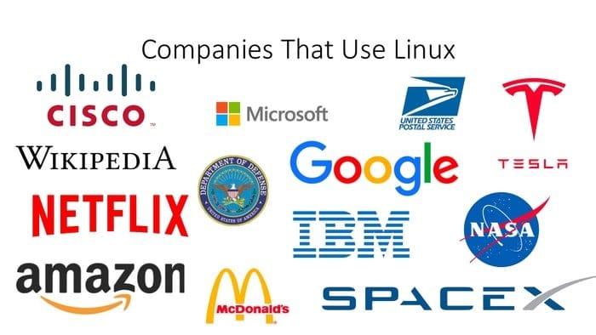
Big companies powered by Linux

Slide 11
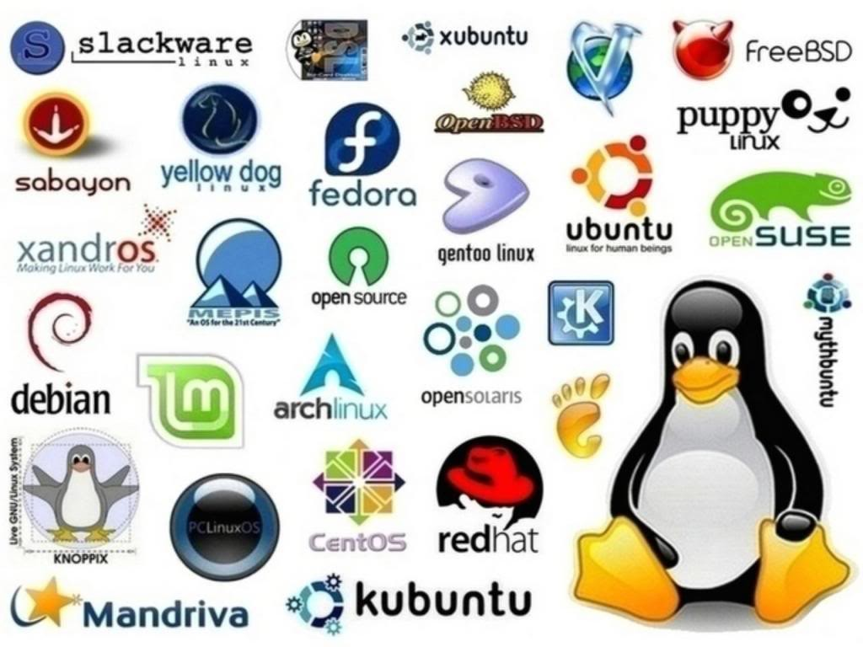
Linux Distributions

